Slide 1
Security Manager System
SMS
SMS is a robust solution designed to efficiently manage system access within CNH while ensuring compliance with audit processes.

Slide 2
Summary
Accessing SMS through ServiceNow
Logging in SMS
Exploring SMS
Creating a ticket
Searching for a ticket
Doubts

Slide 3
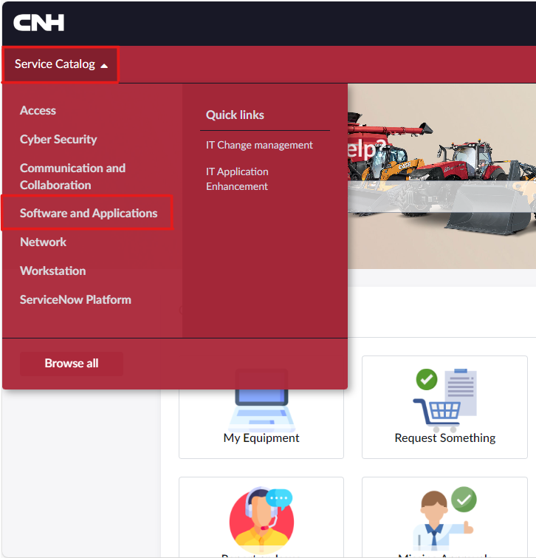
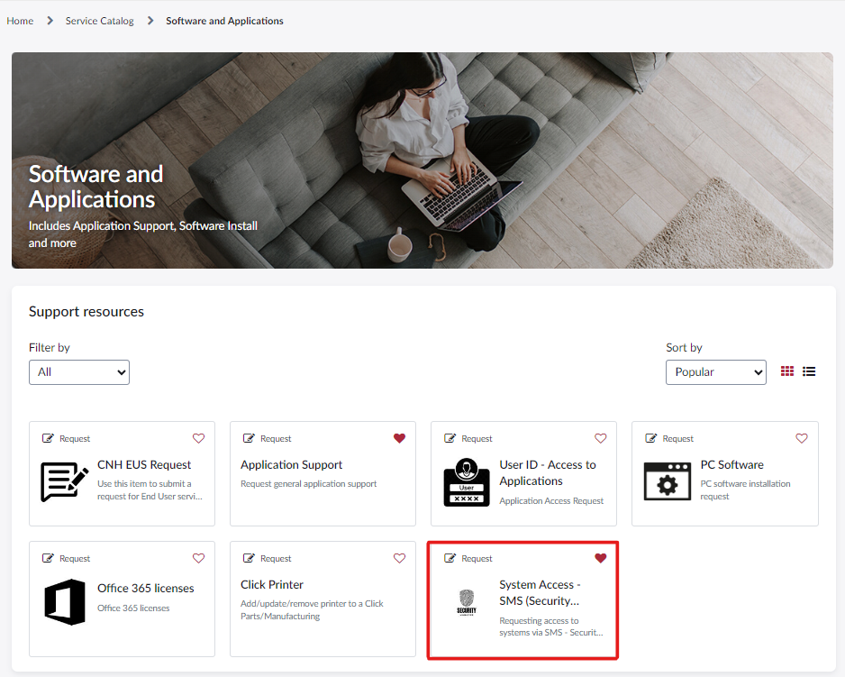
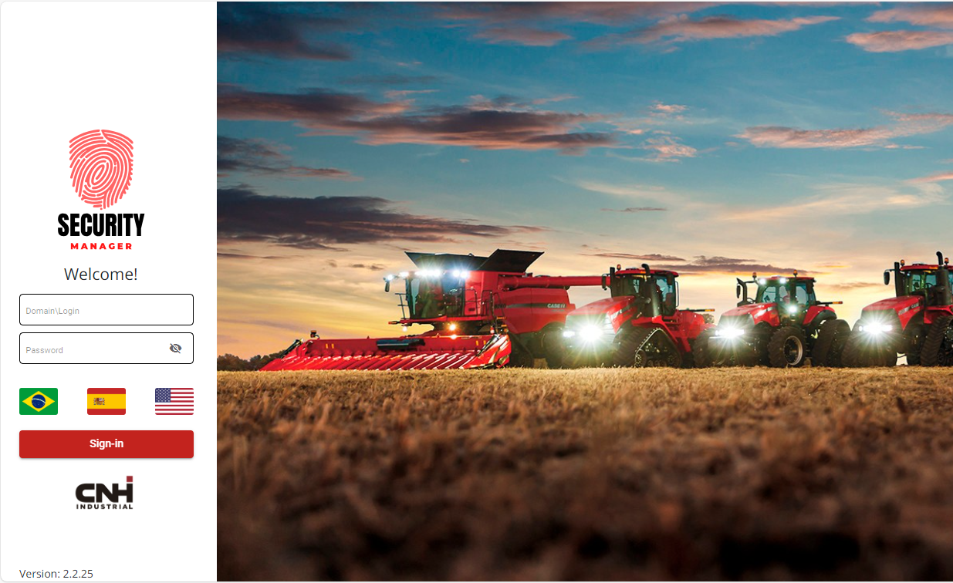
Accessing SMS through ServiceNow
You can find the SMS tool inside ServiceNow, following the steps below:
– Expand the “Service Catalog” menu;
– Select “Software and Applications” option;
– Select “System Access – SMS (Security Manager System)” option;
– SMS will open in a new tab;
– You can also access SMS using the direct link: https://secman.cnhindustrial.com/

Slide 4
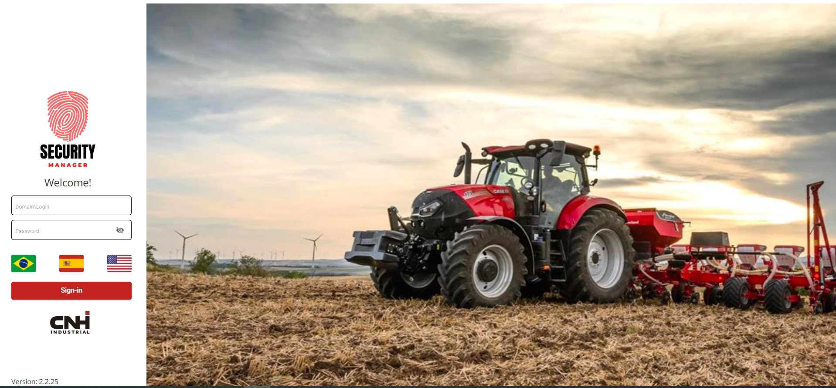
Logging in SMS
To enter in the access management ticket tool, follow the steps below:
– Insert domain\network ID login;
– Network password;
– Choose language by selecting the flag;
– Click “Sign-in” to complete the login.

Slide 5
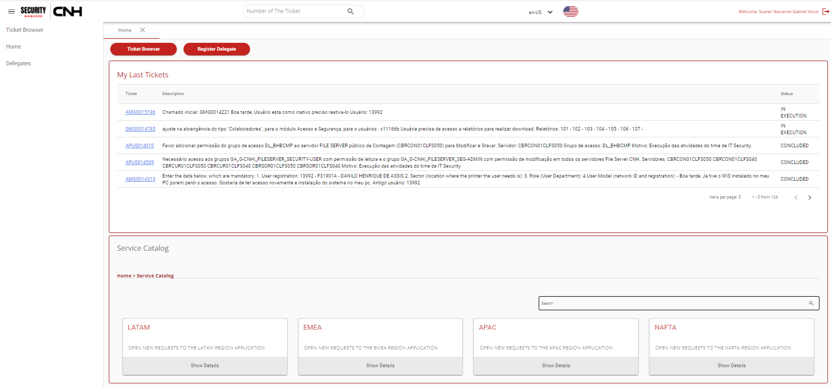
Exploring SMS
This is the home page of SMS, on the left side is the menu and in the middle is the two principal panels which lists you the last tickets you’ve opened and the Service Catalog to open a new one .
Ps.: If there is a ticket waiting for your approval, a Pending Approvals panel will also show .

Slide 6
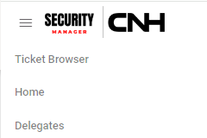
Exploring SMS
Left side menu options:
A) Tickets > Ticket Browser
Load the tickets page where you can find tickets by filtering it.
B) Home
Leads you to the main page.
C) Temporary absence > Delegates
Takes you to delegate registration page, which move your approvals to another collaborator.
A)
B)
C)
First panel “My Last Tickets” shows the ticket you’ve created in the tool. Clicking in the blue ticket name, it will open and you can see all the details, such as Status, Tracking and Notes.

Slide 7
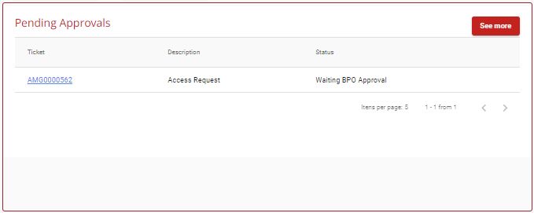
Exploring SMS
Second panel, “Service Catalog” is where we start creating a new ticket. It’s divided by regions, so you can choose the one the system town is allocated and follow the path.
PS.: A third panel will be shown in the main page if you’re an approver of some system and there’s any ticket waiting for your action (to approve or reject).

Slide 8
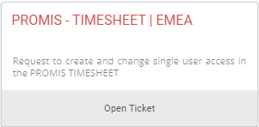
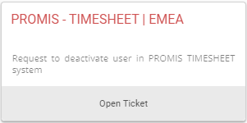
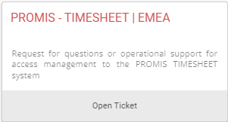
Exploring SMS
Shortcut to SMS Portal:
Press Ctrl + left click on the ticket that suits your needs to be redirected to the SMS ticket form:
PS: If you are landing on the SMS Home Page, log in, then click again on the shortcut.
What are the SMS type of tickets and when use it?
System Access (AMG)
This type of ticket is used to request a single user creation in the Timesheet module, or to request a modification to an existing user’s profile ( cost center, total worked hours etc).
Project (PRO)
This type of ticket is used to request the creation of multiple users in the Timesheet module, or to modify multiple users attributes massively.
Deactivate User (BLK)
This type of ticket is used to deactivate Timesheet user profiles.
P.S. To remove a user’s permissions without deactivating the user, submit a System Access ticket and select the action Remove.
Support (DSO)
This type of ticket is used to ask for support and directions about the ProMIS Timesheet module.

Slide 9
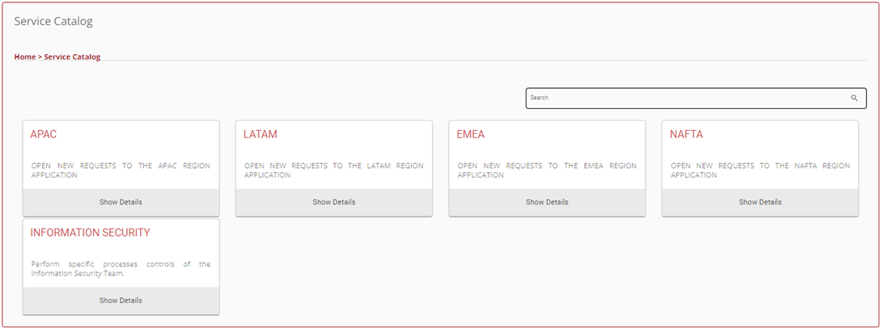
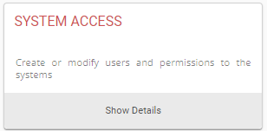
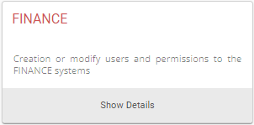
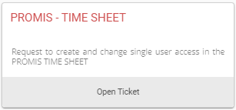
Creating a new ticket (System Access)
To create a new ticket, choose one of the two options:
1 – Navigating through the Service Catalog, you’ll select the region, service category, application town and the system.
2 – Searching the name of the system on the research field and selecting the option wanted to the solicitation.

Slide 10
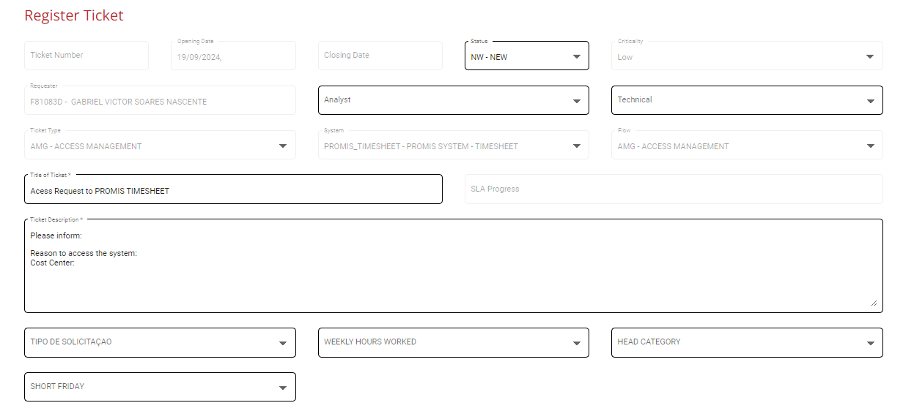
Creating a new ticket (System Access)
After selecting the system, two panels will open: General Information and Access Screen.
General Information is automatically filled with the requestor’s data. The Ticket Description field must be filled with the reason to access the system and the user’s cost center.
Then, fill in the four dropdown menus at the bottom of the page.
When all mandatory fields are complete, click on Next.
A red exclamation mark will warn you that there are empty mandatory fields. When filled, it will turn into a green check mark.

Slide 11
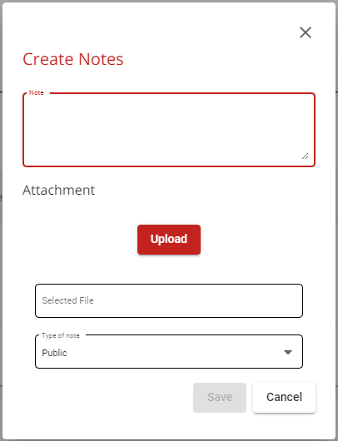
Creating a new ticket
“Notes“ panel is located right below the Description field. By clicking on the + button the user can type a note and mention someone he wants to be notified about the ticket via email. To do so, type a @ sign followed by the person’s name.
Besides typing a note, it is also possible to include a file clicking on the “Upload” button.

Slide 12
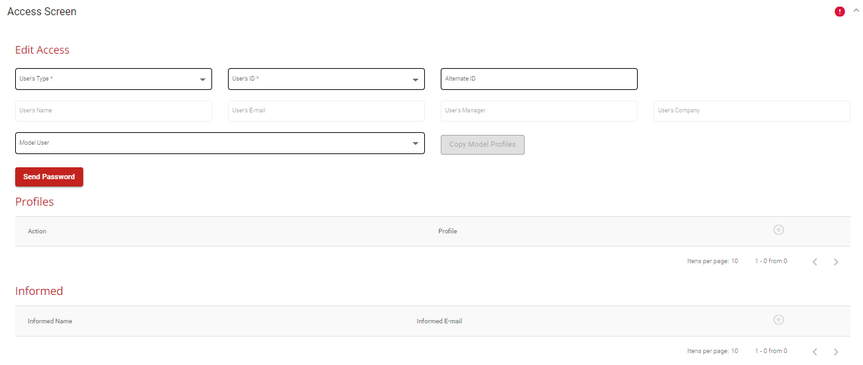
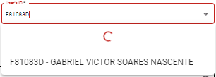
Creating a new ticket (System Access)
The Edit Access panel must be filled with the information about the user who will receive the access.
Alternative ID is used only when the user ID cannot be found in the list or it’s incorrect.
User’s type definitions: Internal: CNH employees and consultants.
External: Suppliers.
System: Application/System accounts.
User ID can be selected both by typing the person’s name or his user ID

Slide 13
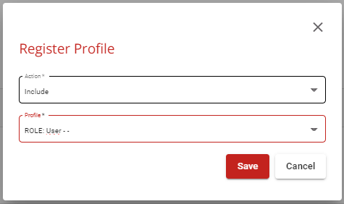
Creating a new ticket (System Access)
The Model User field can be used to grant to a new user the same credentials of a pre-existing known user.
In this case the Profiles section will populate automatically with the known user’s attributes.
The Profiles panel can be filled manually by clicking in the button. A pop-up will appear: select Include in “Action” and select the user’s profile from the dropdown list:

Slide 14
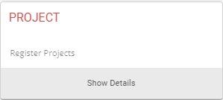
Creating a new ticket (Project)
To create a new ticket, choose one of the two options:
1 – Navigating through the Service Catalog, you’ll select the region, service category, application town and the system.
2 – Searching the name of the system on the research field and selecting the option wanted to the solicitation.

Slide 15
Creating a new ticket (Project)
After selecting the system, two panels will open: General Information and Project.
General Information is automatically filled with the requestor’s data.
Describe in Ticket Description the object of your request.
Please note:
For massive requests the four dropdown menus below the Ticket Description are not mandatory.
Use them only in case the four attributes apply to all the users in your list: Type of request, total worked hours, Head Category, Short Friday Y/N.
The red exclamation dot will warn you that there’re empty mandatory fields. When filled, it will turn into a green check.

Slide 16
Creating a new ticket (Project)
“Notes“ panel is located right below the Description field. By clicking on the + button you can type a note and mention someone you want to be notified about the ticket via email.
To do so, type a @ sign followed by the person’s name.
Besides typing a note, it is also possible to include a file clicking on the “Upload” button.

Slide 17
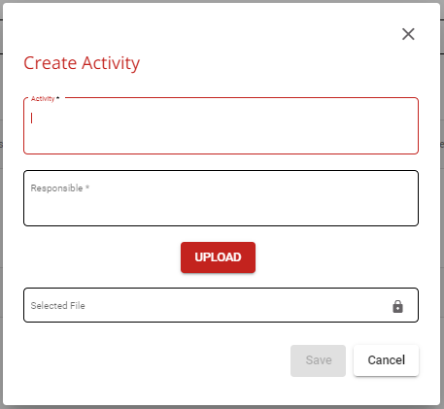
Creating a new ticket (Project)
The Project panel is divided in three sections
Update Project
This section must be filled with the title of your request ( for ex. “Massive users creation” ) , and the timeframe you need the request to be fulfilled (click on the calendar icon to select the dates)
Activities
Indicate in this section the activity type required for the users in your list [Create or Modify]. It’s also possible to attach a file to describe the action.

Slide 18
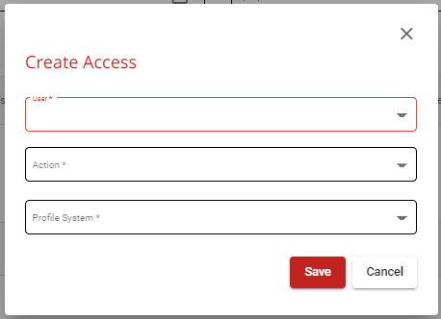
Creating a new ticket (Project)
Access
In this section you can either add the users one by one, or add them massively in a file.
If you want to add the users manually, click on the icon and fill in the pop up with the User ID, Action (Include or Remove the profile) and his Timesheet Profile (Weekly or Monthly view).
If, instead, you want to add the users massively, click on the icon to download the Timesheet profiles list.
Then click on to download the SMS template. Fill in the template with the following mandatory info:
User ID
Profile ( Select one from the Profiles file , and paste it in column “Code” )
When the list is ready, Click on the button to upload the template.
To submit the ticket, click on
New Profile
This section must be ignored. It is used only by the IT Application team.

Slide 19
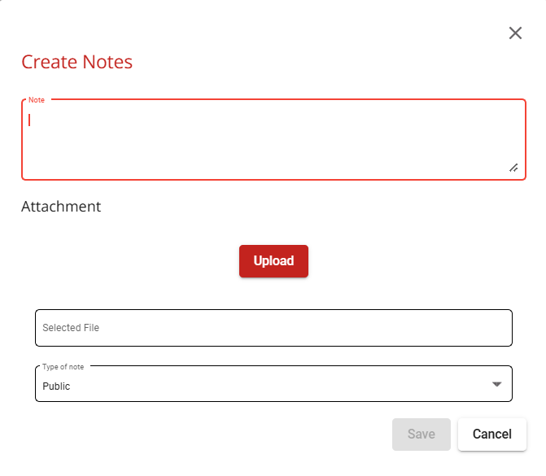
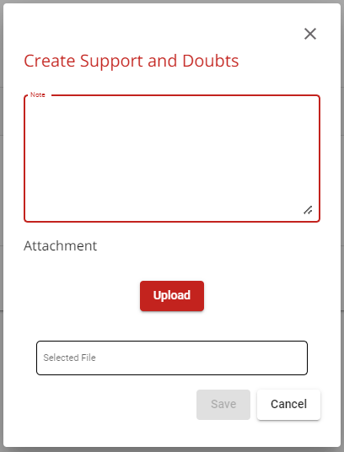
Creating a new ticket (User Blocking/Support)
The first panel of the Blocking and Support ticket is General Information. After describing the action required in the General Information panel, click on “Next”.
Please note: If you want someone to be informed about this ticket, use the Notes section.
The Notes section allows the user to mention someone, so they will receive a notification via email.
P.S.: To mention someone, just add a @ sign and type the person’s name, example: @GABRIEL VICTOR…
In the following panel Support and Doubts, click on the “ icon and write/attach in the pop up the list of users to deactivate. Once completed, click on the Save All button to submit the ticket.

Slide 20
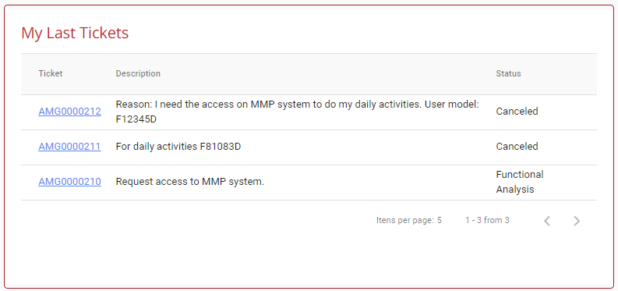
Searching for a ticket
There are 3 different ways of searching for a ticket in the SMS:
– My last tickets;
– Research field;
– Filter panel;
Tickets also can be found by the execution of a filter choosing by Ticket Type, Ticket Number, System, Status, My Tickets, Open Tickets, Attended Users and Criticality.
For that, you need to click in the red button “Ticket Browser” in the home page, then the filter panel will appear.
Research field can be found in the top of any screen when logged in SMS, by inserting the ticket number and pressing “Enter”, a new tab inside of the system will lead you to the ticket you’re looking for.
My Last Tickets panel will always be shown in the home page of SMS, you can navigate through the pages inside of the panel to find the ticket you’ve opened before.

Slide 21
Any doubt left?
Contact LATAM Security team through email: SAICTSECURITY@CNHIND.COM
Watch videos presenting SMS actions, click in the options to be directed:
SMS Presentation
Tickets Creation
Tickets Approval
AMG0001
GMG0001
Delegate Creation
Tickets Search

